Slide 1
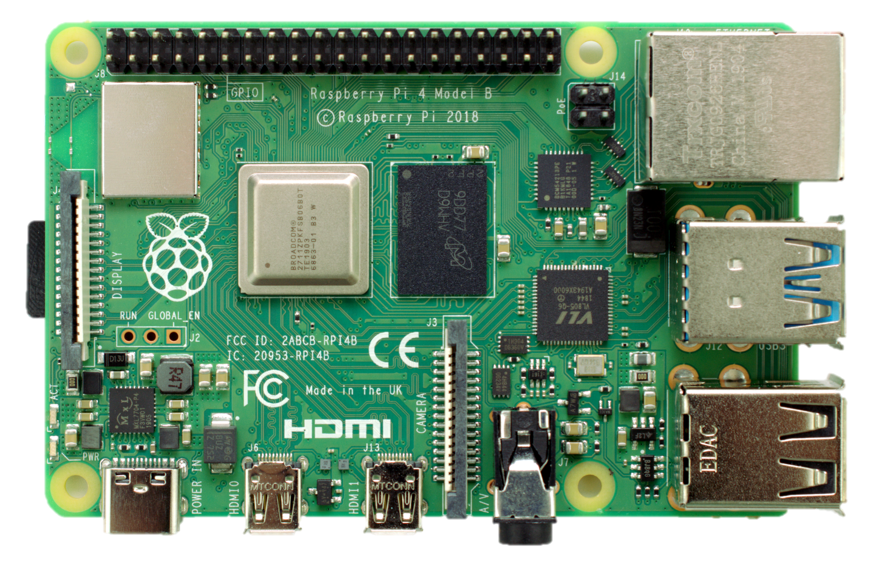

Slide 2
description

Slide 3
another description

Slide 4

Hardware

Slide 5
Hardware
gigabit ethernet
2 x USB 3.0
2 x USB 2.0

Slide 6
Hardware
USB-C Power
2 x micro HDMI
stereo audio

Slide 7
wireless
bluetooth
micro SD
display port

Slide 8
CPU
RAM

